Slide 1
Evolutionary Computing
Dr. T presents…
COMP 5660/6660/6666

Slide 2
Introduction
The field of Evolutionary Computing studies the theory and application of Evolutionary Algorithms.
Evolutionary Algorithms can be described as a class of stochastic, population-based local search algorithms inspired by neo-Darwinian Evolution Theory.

Slide 3
Motivation
Many computational problems can be formulated as generate-and-test problems

Slide 4
Search Space
A search space contains the set of all possible solutions
A search space generator is complete if it can generate the entire search space
An objective function tests the quality of a solution
A heuristic is a problem-dependent rule-of-thumb

Slide 5
Metaheuristics & BBSAs
A metaheuristic determines the sampling order over the search space with the goal to find a near-optimal solution (or set of solutions)
A Black-Box Search Algorithm (BBSA) is a metaheuristic which iteratively generates trial solutions employing solely the information gained from previous trial solutions, but no explicit problem knowledge
Notes:
Performance is measured in terms of the quality of the individuals discovered by the search heuristic. Formally, a performance metric maps sequences of objective values to a real number indicating how well a heuristic which observed that sequence performed. Examples of performance metrics include the last objective value discovered by the algorithm or the greatest objective value discovered so far.

Slide 6
Computational Basis
Trial-and-error (aka Generate-and-test)
Graduated solution quality
Stochastic local search of adaptive solution landscape
Local vs. global optima
Unimodal vs. multimodal problems

Slide 7
Biological Metaphors
Darwinian Evolution
Macroscopic view of evolution
Natural selection
Survival of the fittest
Random variation

Slide 8
Biological Metaphors
(Mendelian) Genetics
Genotype (functional unit of inheritance)
Genotypes vs. phenotypes
Pleitropy: one gene affects multiple phenotypic traits
Polygeny: one phenotypic trait is affected by multiple genes
Chromosomes (haploid vs. diploid)
Loci and alleles

Slide 9
Computational Problem Classes
Optimization problems
Modeling (aka system identification) problems
Simulation problems

Slide 10
EA Pros
More general purpose than traditional optimization algorithms; i.e., less problem specific knowledge required
Ability to solve “difficult” problems
Solution availability
Robustness
Inherent parallelism

Slide 11
EA Cons
Fitness function and genetic operators often not obvious
Premature convergence
Computationally intensive
Difficult parameter optimization

Slide 12
EA components
Search spaces: representation & size
Evaluation of trial solutions: fitness function
Exploration versus exploitation
Selective pressure rate
Premature convergence

Slide 13
Nature versus the digital realm
Environment | Problem (search space)
Fitness | Fitness function
Population | Set
Individual | Datastructure
Genes | Elements
Alleles | Datatype

Slide 14
EA Strategy Parameters
Population size
Initialization related parameters
Selection related parameters
Number of offspring
Recombination chance
Mutation chance
Mutation rate
Termination related parameters

Slide 15
Problem solving steps
Collect problem knowledge
Choose gene representation
Design fitness function
Creation of initial population
Parent selection
Decide on genetic operators
Competition / survival
Choose termination condition
Find good parameter values

Slide 16
Function optimization problem
Given the function
f(x,y) = x²y + 5xy – 3xy²
for what integer values of x and y is f(x,y) minimal?

Slide 17
Function optimization problem
Solution space: Z x Z
Trial solution: (x,y)
Gene representation: integer
Gene initialization: random
Fitness function: -f(x,y)
Population size: 4
Number of offspring: 2
Parent selection: exponential

Slide 18
Function optimization problem
Genetic operators:
1-point crossover
Mutation (-1,0,1)
Competition:
remove the two individuals with the lowest fitness value

Slide 20
Measuring performance
Case 1: goal unknown or never reached
Solution quality: global average/best population fitness
Case 2: goal known and sometimes reached
Optimal solution reached percentage
Case 3: goal known and always reached
Speed (convergence, wall time, etc.)

Slide 21
Initialization
Uniform random
Heuristic based
Knowledge based
Genotypes from previous runs
Seeding

Slide 22
Representation (§3.2.1)
Genotype space
Phenotype space
Encoding & Decoding
Knapsack Problem (§3.4.2)
Surjective, injective, and bijective decoder functions

Slide 23
Simple Genetic Algorithm (SGA)
Representation: Bit-strings
Recombination: 1-Point Crossover
Mutation: Bit Flip
Parent Selection: Fitness Proportional
Survival Selection: Generational

Slide 24
Trace example errata for 1st printing of 1st edition of textbook
Page 39, line 5, 729 -> 784
Table 3.4, x Value, 26 -> 28, 18 -> 20
Table 3.4, Fitness:
676 -> 784
324 -> 400
2354 -> 2538
588.5 -> 634.5
729 -> 784

Slide 25
Representations
Bit Strings
Scaling Hamming Cliffs
Binary vs. Gray coding
Integers
Ordinal vs. cardinal attributes
Permutations
Absolute order vs. adjacency
Real-Valued, etc.
Homogeneous vs. heterogeneous

Slide 26
Permutation Representation
Order based (e.g., job shop scheduling)
Adjacency based (e.g., TSP)
Problem space: [A,B,C,D]
Permutation: [3,1,2,4]
Mapping 1: [C,A,B,D]
Mapping 2: [B,C,A,D]

Slide 27
Mutation vs. Recombination
Mutation = Stochastic unary variation operator
Recombination = Stochastic multi-ary variation operator

Slide 28
Mutation
Bit-String Representation:
Bit-Flip
E[#flips] = L * p_{m}
Integer Representation:
Random Reset (cardinal attributes)
Creep Mutation (ordinal attributes)

Slide 29
Mutation cont.
Floating-Point
Uniform
Nonuniform from fixed distribution
Gaussian, Cauche, Levy, etc.

Slide 30
Permutation Mutation
Swap Mutation
Insert Mutation
Scramble Mutation
Inversion Mutation (good for adjacency based problems)

Slide 31
Recombination
Recombination rate: asexual vs. sexual
N-Point Crossover (positional bias)
Uniform Crossover (distributional bias)
Discrete recombination (no new alleles)
(Uniform) arithmetic recombination
Simple recombination
Single/whole arithmetic recombination
Blend Crossover

Slide 32
Permutation Recombination
Adjacency based problems
Partially Mapped Crossover (PMX)
Edge Crossover
Order based problems
Order Crossover
Cycle Crossover

Slide 33
PMX
Choose 2 random crossover points & copy mid-segment from p1 to offspring
Look for elements in mid-segment of p2 that were not copied
For each of these (i), look in offspring to see what copied in its place (j)
Place i into position occupied by j in p2
If place occupied by j in p2 already filled in offspring by k, put i in position occupied by k in p2
Rest of offspring filled by copying p2

Slide 34
Order Crossover
Choose 2 random crossover points & copy mid-segment from p1 to offspring
Starting from 2nd crossover point in p2, copy unused numbers into offspring in the order they appear in p2, wrapping around at end of list

Slide 35
Population Models
Two historical models
Generational Model
Steady State Model
Generational Gap
General model
Population size
Mating pool size
Offspring pool size

Slide 36
Parent selection
Random
Fitness Based
Proportional Selection (FPS)
Rank-Based Selection
Genotypic/phenotypic Based

Slide 37
Fitness Proportional Selection
High risk of premature convergence
Uneven selective pressure
Fitness function not transposition invariant
Windowing
f’(x)=f(x)-β^{t} with β^{t}=min_{y in P}^{t}f(y)
Dampen by averaging β^{t} over last k gens
Goldberg’s Sigma Scaling
f’(x)=max(f(x)-(f_{avg}-c*δ_{f}),0.0) with c=2 and δ_{f} is the standard deviation in the population

Slide 38
Rank-Based Selection
Mapping function (ala SA cooling schedule)
Exponential Ranking
Linear ranking

Slide 39
Sampling methods
Roulette Wheel
Stochastic Universal Sampling (SUS)

Slide 40
Rank based sampling methods
Tournament Selection
Tournament Size

Slide 41
Survivor selection
Age-based
Fitness-based
Truncation
Elitism

Slide 42
Termination
CPU time / wall time
Number of fitness evaluations
Lack of fitness improvement
Lack of genetic diversity
Solution quality / solution found
Combination of the above

Slide 43
Behavioral observables
Selective pressure
Population diversity
Fitness values
Phenotypes
Genotypes
Alleles

Slide 44
EA dynamics (1)
EV:
Randomly generate initial population
Do Forever:
Randomly select a parent
Clone selected parent and mutate offspring
Randomly select an adult and terminate the less fit of the selected adult and the offspring

Slide 45
EA dynamics (2)
EV’s behavior on f(x1,x2)=x1² + x2²
EV will randomly converge to a homogeneous fixed point on one of the peaks
EV’s population will split into four subpopulations, each converged on one of the peaks
EV will oscillate indefinitely among the peaks
Opposing pressures result in a dynamic equilibrium in the middle of the valley

Slide 46
Constraint Handling
Ignore constraints
Kill invalid offspring
Feasible phenotype mapping decoder
Repair function
Feasible solution space closed under variation operators
Penalty function

Slide 47
Ignore constraints
Ignore the constraints under the motto: all is well that ends well

Slide 48
Kill invalid offspring

Slide 49
Feasible phenotype mapping decoder

Slide 50
Repair function

Slide 51
Feasible solution space closed under variation operators

Slide 52
Penalty function

Slide 53
Multi-Objective EAs (MOEAs)
Extension of regular EA which maps multiple objective values to single fitness value
Objectives typically conflict
In a standard EA, an individual A is said to be better than an individual B if A has a higher fitness value than B
In a MOEA, an individual A is said to be better than an individual B if A dominates B

Slide 54
Domination in MOEAs
An individual A is said to dominate individual B iff:
A is no worse than B in all objectives
A is strictly better than B in at least one objective

Slide 55
Pareto Optimality (Vilfredo Pareto)
Given a set of alternative allocations of, say, goods or income for a set of individuals, a movement from one allocation to another that can make at least one individual better off without making any other individual worse off is called a Pareto Improvement. An allocation is Pareto Optimal when no further Pareto Improvements can be made. This is often called a Strong Pareto Optimum (SPO).

Slide 56
Pareto Optimality in MOEAs
Among a set of solutions P, the non-dominated subset of solutions P’ are those that are not dominated by any member of the set P
The non-dominated subset of the entire feasible search space S is the globally Pareto-optimal set

Slide 57
Goals of MOEAs
Identify the Global Pareto-Optimal set of solutions (aka the Pareto Optimal Front)
Find a sufficient coverage of that set
Find an even distribution of solutions

Slide 58
MOEA metrics
Convergence: How close is a generated solution set to the true Pareto-optimal front
Diversity: Are the generated solutions evenly distributed, or are they in clusters

Slide 59
Deterioration in MOEAs
Competition can result in the loss of a non-dominated solution which dominated a previously generated solution
This loss in its turn can result in the previously generated solution being regenerated and surviving

Slide 60
NSGA-II
Initialization – before primary loop
Create initial population P₀
Sort P₀ on the basis of non-domination
Best level is level 1
Fitness is set to level number; lower number, higher fitness
Binary Tournament Selection
Mutation and Recombination create Q₀

Slide 61
NSGA-II (cont.)
Primary Loop
R_{t} = P_{t} + Q_{t}
Sort R_{t} on the basis of non-domination
Create P_{t + 1} by adding the best individuals from R_{t}
Create Q_{t + 1} by performing Binary Tournament Selection, Recombination, and Mutation on P_{t + 1}

Slide 62
NSGA-II (cont.)
Crowding distance metric: average side length of cuboid defined by nearest neighbors in same front
Parent tournament selection employs crowding distance as a tie breaker

Slide 63
Epsilon-MOEA
Steady State
Elitist
No deterioration

Slide 64
Epsilon-MOEA (cont.)
Create an initial population P(0)
Epsilon non-dominated solutions from P(0) are put into an archive population E(0)
Choose one individual from E, and one from P
These individuals mate and produce an offspring, c
A special array B is created for c, which consists of abbreviated versions of the objective values from c

Slide 65
Epsilon-MOEA (cont.)
An attempt to insert c into the archive population E
The domination check is conducted using the B array instead of the actual objective values
If c dominates a member of the archive, that member will be replaced with c
The individual c can also be inserted into P in a similar manner using a standard domination check

Slide 66
SNDL-MOEA
Desired Features
Deterioration Prevention
Stored non-domination levels (NSGA-II)
Number and size of levels user configurable
Selection methods utilizing levels in different ways
Problem specific representation
Problem specific “compartments” (E-MOEA)
Problem specific mutation and crossover

Slide 67
Report writing tips
Use easily readable fonts, including in tables & graphs (11 pnt fonts are typically best, 10 pnt is the absolute smallest)
Number all figures and tables and refer to each and every one in the main text body (hint: use autonumbering)
Capitalize named articles (e.g., ``see Table 5'', not ``see table 5'')
Keep important figures and tables as close to the referring text as possible, while placing less important ones in an appendix
Always provide standard deviations (typically in between parentheses) when listing averages

Slide 68
Report writing tips
Use descriptive titles, captions on tables and figures so that they are self-explanatory
Always include axis labels in graphs
Write in a formal style (never use first person, instead say, for instance, ``the author'')
Format tabular material in proper tables with grid lines
Avoid making explicit physical layout references like “in the below table” or “in the figure on the next page”; instead use logical layout references like “in Table” or “in the previous paragraph”
Provide all the required information, but avoid extraneous data (information is good, data is bad)

Slide 69
Evolutionary Programming (EP)
Traditional application domain: machine learning by FSMs
Contemporary application domain: (numerical) optimization
arbitrary representation and mutation operators, no recombination
contemporary EP = traditional EP + ES
self-adaptation of parameters

Slide 70
EP technical summary tableau
Representation | Real-valued vectors
Recombination | None
Mutation | Gaussian perturbation
Parent selection | Deterministic
Survivor selection | Probabilistic (μ+μ)
Specialty | Self-adaptation of mutation step sizes (in meta-EP)

Slide 71
Historical EP perspective
EP aimed at achieving intelligence
Intelligence viewed as adaptive behaviour
Prediction of the environment was considered a prerequisite to adaptive behaviour
Thus: capability to predict is key to intelligence

Slide 72
Prediction by finite state machines
Finite state machine (FSM):
States S
Inputs I
Outputs O
Transition function δ : S x I → S x O
Transforms input stream into output stream
Can be used for predictions, e.g. to predict next input symbol in a sequence

Slide 73
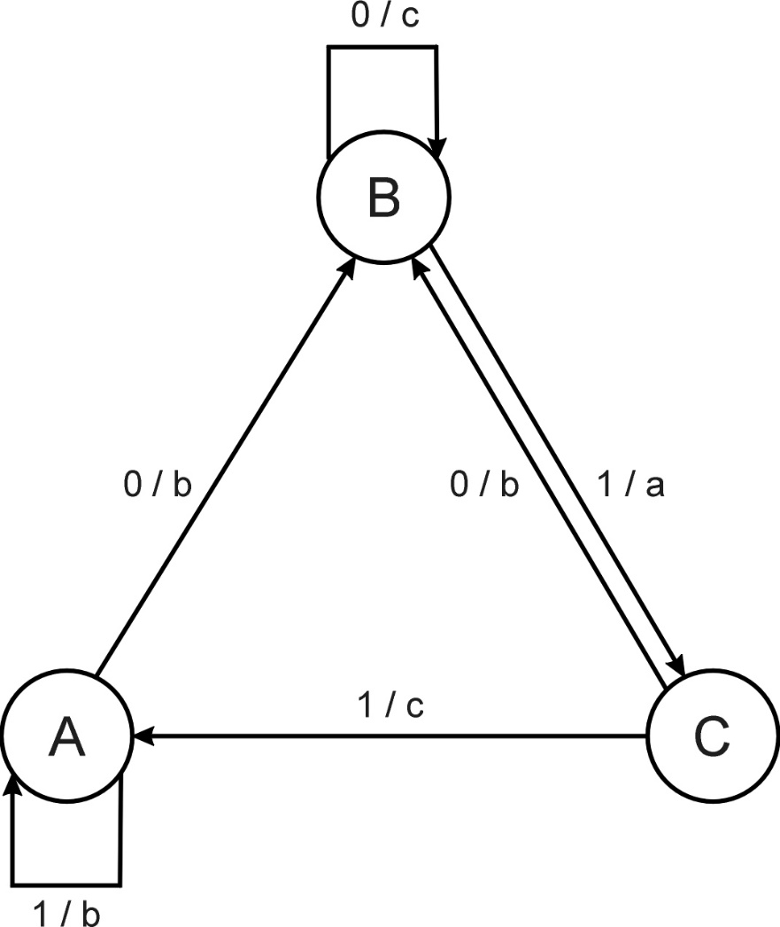
FSM example
Consider the FSM with:
S = {A, B, C}
I = {0, 1}
O = {a, b, c}
δ given by a diagram

Slide 74
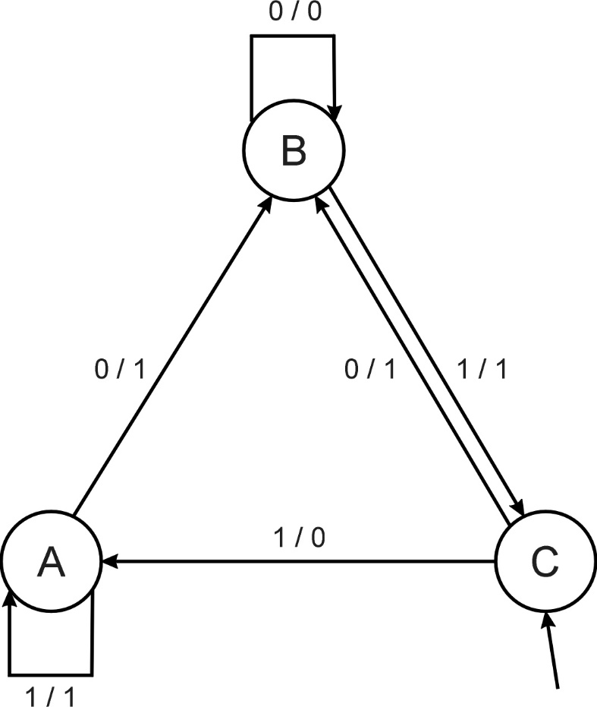
FSM as predictor
Consider the following FSM
Task: predict next input
Quality: % of in_{(i+1)} = out_{i}
Given initial state C
Input sequence 011101
Leads to output 110111
Quality: 3 out of 5

Slide 75
Introductory example: evolving FSMs to predict primes
P(n) = 1 if n is prime, 0 otherwise
I = N = {1,2,3,…, n, …}
O = {0,1}
Correct prediction: out_{i}= P(in_{(i+1)})
Fitness function:
1 point for correct prediction of next input
0 point for incorrect prediction
Penalty for “too many” states

Slide 76
Introductory example: evolving FSMs to predict primes
Parent selection: each FSM is mutated once
Mutation operators (one selected randomly):
Change an output symbol
Change a state transition (i.e. redirect edge)
Add a state
Delete a state
Change the initial state
Survivor selection: (μ+μ)
Results: overfitting, after 202 inputs best FSM had one state and both outputs were 0, i.e., it always predicted “not prime”

Slide 77
Modern EP
No predefined representation in general
Thus: no predefined mutation (must match representation)
Often applies self-adaptation of mutation parameters
In the sequel we present one EP variant, not the canonical EP

Slide 78
Representation
For continuous parameter optimisation
Chromosomes consist of two parts:
Object variables: x₁,…,x_{n}
Mutation step sizes: σ₁,…,σ_{n}
Full size: ⟨ x₁,…,x_{n}, σ₁,…,σ_{n} ⟩

Slide 79
Mutation
Chromosomes: ⟨ x₁,…,x_{n}, σ₁,…,σ_{n} ⟩
σ_{i}’ = σ_{i} • (1 + α • N(0,1))
x’_{i} = x_{i} + σ_{i}’ • N_{i}(0,1)
α ≈ 0.2
boundary rule: σ’ < ε₀ ⇒ σ’ = ε₀
Other variants proposed & tried:
Lognormal scheme as in ES
Using variance instead of standard deviation
Mutate σ-last
Other distributions, e.g, Cauchy instead of Gaussian

Slide 80
Recombination
None
Rationale: one point in the search space stands for a species, not for an individual and there can be no crossover between species
Much historical debate “mutation vs. crossover”
Pragmatic approach seems to prevail today

Slide 81
Parent selection
Each individual creates one child by mutation
Thus:
Deterministic
Not biased by fitness

Slide 82
Survivor selection
P(t): μ parents, P’(t): μ offspring
Pairwise competitions, round-robin format:
Each solution x from P(t) ∪ P’(t) is evaluated against q other randomly chosen solutions
For each comparison, a "win" is assigned if x is better than its opponent
The μ solutions with greatest number of wins are retained to be parents of next generation
Parameter q allows tuning selection pressure (typically q = 10)

Slide 83
Example application: the Ackley function (Bäck et al ’93)
The Ackley function (with n =30):
Representation:
-30 < x_{i} < 30 (coincidence of 30’s!)
30 variances as step sizes
Mutation with changing object variables first!
Population size μ = 200, selection q = 10
Termination after 200,000 fitness evals
Results: average best solution is 1.4 • 10 ^{–2}

Slide 84
Example application: evolving checkers players (Fogel’02)
Neural nets for evaluating future values of moves are evolved
NNs have fixed structure with 5046 weights, these are evolved + one weight for “kings”
Representation:
vector of 5046 real numbers for object variables (weights)
vector of 5046 real numbers for σ‘s
Mutation:
Gaussian, lognormal scheme with σ-first
Plus special mechanism for the kings’ weight
Population size 15

Slide 85
Example application: evolving checkers players (Fogel’02)
Tournament size q = 5
Programs (with NN inside) play against other programs, no human trainer or hard-wired intelligence
After 840 generation (6 months!) best strategy was tested against humans via Internet
Program earned “expert class” ranking outperforming 99.61% of all rated players

Slide 86
Deriving Gas-Phase Exposure History through Computationally Evolved Inverse Diffusion Analysis
Joshua M. Eads
Former undergraduate student in Computer Science
Daniel Tauritz
Associate Professor of Computer Science
Glenn Morrison
Associate Professor of Environmental Engineering
Ekaterina Smorodkina
Former Ph.D. Student in Computer Science

Slide 87

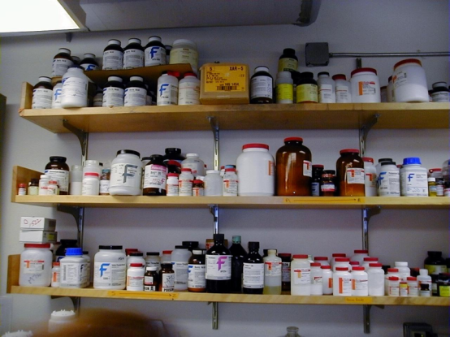

Introduction
Find Contaminants
and Fix Issues
Examine Indoor
Exposure History
Unexplained
Sickness

Slide 88
Background
Indoor air pollution top five environmental health risks
$160 billion could be saved every year by improving indoor air quality
Current exposure history is inadequate
A reliable method is needed to determine past contamination levels and times

Slide 89
Problem Statement
A forward diffusion differential equation predicts concentration in materials after exposure
An inverse diffusion equation finds the timing and intensity of previous gas contamination
Knowledge of early exposures would greatly strengthen epidemiological conclusions

Slide 90
Gas-phase concentration history and material absorption

Slide 91
Proposed Solution
Use Genetic Programming (GP) as a directed search for inverse equation
Fitness based on forward equation
x^5 + x^4 - tan(y) / pi
x^2 + sin(x)
sin(cos(x+y)^2)
sin(x+y) + e^(x^2)
5x^2 + 12x - 4
x^2 - sin(x)
X
+
Sin
/
?

Slide 92
Related Research
It has been proven that the inverse equation exists
Symbolic regression with GP has successfully found both differential equations and inverse functions
Similar inverse problems in thermodynamics and geothermal research have been solved

Slide 93
Interdisciplinary Work
Collaboration between Environmental Engineering, Computer Science, and Math
Parent Selection
Candidate
Solutions
Forward Diffusion Equation
Competition
Reproduction
Population
Fitness
Genetic Programming Algorithm

Slide 94
Genetic Programming Background
+
Y = X^2 + Sin( X * Pi )
*
Sin
X
X
*
X
Pi

Slide 95


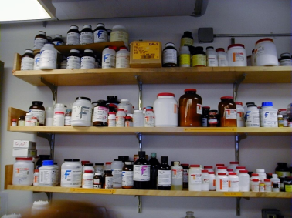
Summary
Ability to characterize exposure history will enhance ability to assess health risks of chemical exposure

Slide 96
Genetic Programming (GP)
Characteristic property: variable-size hierarchical representation vs. fixed-size linear in traditional EAs
Application domain: model optimization vs. input values in traditional EAs
Unifying Paradigm: Program Induction

Slide 97
Program induction examples
Optimal control
Planning
Symbolic regression
Automatic programming
Discovering game playing strategies
Forecasting
Inverse problem solving
Decision Tree induction
Evolution of emergent behavior
Evolution of cellular automata

Slide 98
GP specification
S-expressions
Function set
Terminal set
Arity
Correct expressions
Closure property
Strongly typed GP

Slide 99
GP operators
Initialization
Ramped-half-and-half
Full method
Grow method
Mutation xor recombination
Low mutation chance (recombination acts as macromutation operator)

Slide 100
GP operators (continued)
Over-selection
Large population sizes
Split pop into top x% and rest
80% from first group, 20% from second
x chosen such that number of parents producing majority of offspring stays constant
Bloat (survival of the fattest)
Parsimony pressure

Slide 101
Learning Classifier Systems (LCS)
Motivation
Expert Systems introduced in 1965 by the Stanford Heuristic Programming Project
Condition-Action Rule Based Systems
rule format: <condition:action>
Famous early systems: MYCIN, DENDRAL
Drawback: inability to learn

Slide 102
Learning Classifier Systems (LCS)
Illustrative example:
k-bit multiplexer problem

Slide 103
Learning Classifier Systems (LCS)
LCS is technically not a type of EA, but can utilize an EA
Combines Classification with Reinforcement Learning
LCS rule format:
<condition:action> → predicted payoff
don’t care symbols

Slide 104
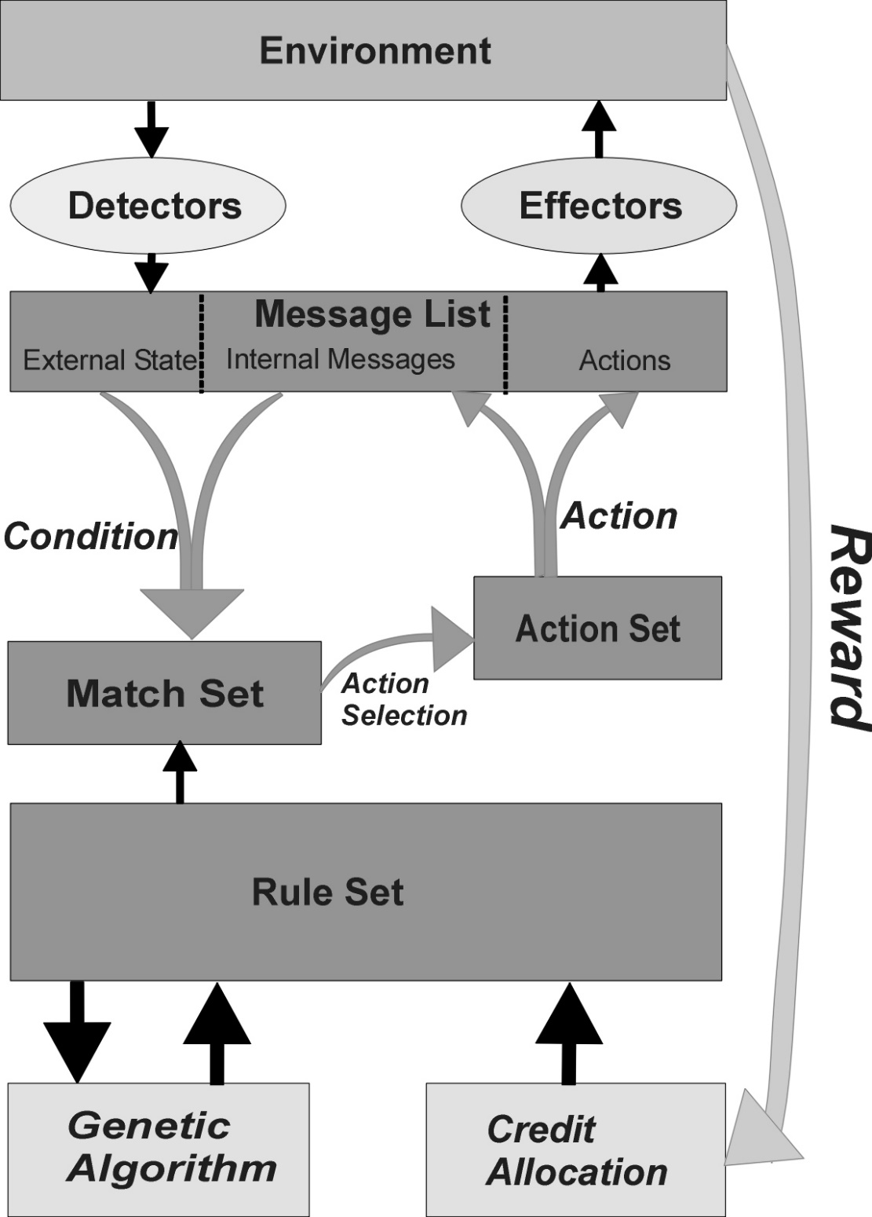

Slide 105
Learning Classifier Systems (LCS)
Illustrative example:
solving k-bit multiplexer problem with LCS

Slide 106

LCS specifics
Multi-step credit allocation – Bucket Brigade algorithm

Slide 107
LCS specifics
Michigan approach: each individual represents a single rule, a population represents the complete rule set
Pittsburgh “Pitt” approach: each individual represents a complete rule set

Slide 108
Parameter Tuning methods
Start with stock parameter values
Manually adjust based on user intuition
Monte Carlo sampling of parameter values on a few (short) runs
Tuning algorithm (e.g., REVAC which employs an information theoretic measure on how sensitive performance is to the choice of a parameter’s value)
Meta-tuning algorithm (e.g., meta-EA)

Slide 109
Parameter Tuning Challenges
Exhaustive search for optimal values of parameters, even assuming independency, is infeasible
Parameter dependencies
Extremely time consuming
Optimal values are very problem specific

Slide 110
Static vs. dynamic parameters
The optimal value of a parameter can change during evolution
Static parameters remain constant during evolution, dynamic parameters can change
Dynamic parameters require parameter control

Slide 111
Tuning vs Control confusion
Parameter Tuning: A priori optimization of fixed strategy parameters
Parameter Control: On-the-fly optimization of dynamic strategy parameters

Slide 112
Parameter Control
While dynamic parameters can benefit from tuning, performance tends to be much less sensitive to initial values for dynamic parameters than static
Controls dynamic parameters
Three main parameter control classes:
Blind
Adaptive
Self-Adaptive

Slide 113
Parameter Control methods
Blind (termed “deterministic” in textbook)
Example: replace p_{i} with p_{i}(t)
akin to cooling schedule in Simulated Annealing
Adaptive
Example: Rechenberg’s 1/5 success rule
Self-adaptive
Example: Mutation-step size control in ES

Slide 114
Evaluation Function Control
Example 1: Parsimony Pressure in GP
Example 2: Penalty Functions in Constraint Satisfaction Problems (aka Constrained Optimization Problems)

Slide 115
Penalty Function Control
eval(x)=f(x)+W ·penalty(x)
Blind ex: W=W(t)=(C ·t)^{α} with C,α≥1
Adaptive ex (page 135 of textbook)
Self-adaptive ex (pages 135-136 of textbook)
Note: this allows evolution to cheat!

Slide 116
Parameter Control aspects
What is changed?
Parameters vs. operators
What evidence informs the change?
Absolute vs. relative

Slide 117
Parameter Control: Scope of Change
Gene vs. individual vs. population
Ex: one-bit allele for recombination operator selection (pairwise vs. vote)
Ex:
Gene: Self-adaptive ES with separate mutation step sizes ⟨ x₁,…,x_{n}, σ₁,…, σ_{n} ⟩
Individual: Self-adaptive ES with single mutation step size ⟨ x₁,…,x_{n}, σ ⟩
Population: Blind dynamic mutation control

Slide 118
Parameter control examples
Representation (GP:ADFs, delta coding)
Evaluation function (objective function/…)
Mutation (ES)
Recombination (Davis’ adaptive operator fitness:implicit bucket brigade)
Selection (Boltzmann)
Population
Multiple

Slide 119
Population Size Control
1994 Genetic Algorithm with Varying Population Size (GAVaPS)
2000 Genetic Algorithm with Adaptive Population Size (APGA)
– dynamic population size as emergent behavior of individual survival tied to age
– both introduce two new parameters: MinLT and MaxLT; furthermore, population size converges to 0.5 * λ * (MinLT + MaxLT)
Notes:
In both GAVaPS and APGA, each individual is given a lifetime, which depends on the individual’s fitness. At each generation, individuals’ lifetimes are decreased by one. The main difference between APGA and GAVaPS is that in APGA the lifetime of the fittest individual at each generation remains unchanged, while in GAVaPS the lifetime of all individuals in the population is decreased at each generation.

Slide 120
Population Size Control
1995 (1,λ)-ES with dynamic offspring size employing adaptive control
– adjusts λ based on the second best individual created
– goal is to maximize local serial progress-rate, i.e., expected fitness gain per fitness evaluation
– maximizes convergence rate, which often leads to premature convergence on complex fitness landscapes
Notes:
Hansen, Gawelczyk, and Ostermeier
This paper presents an analysis of the local serial rate of progress with respect to the number of offspring λ for the (1,λ)-evolution strategy. It is shown that local serial progress is maximized when the expected progress of the second best offspring is zero. The theoretical results lead to a simple but efficient adaptation rule for λ, which needs no extra fitness function evaluations and only small computational expense.

Slide 121
Population Size Control
1999 Parameter-less GA
– runs multiple fixed size populations in parallel
– the sizes are powers of 2, starting with 4 and doubling the size of the largest population to produce the next largest population
– smaller populations are preferred by allotting them more generations
– a population is deleted if a) its average fitness is exceeded by the average fitness of a larger population, or b) the population has converged
– no limit on number of parallel populations

Slide 122
Population Size Control
2003 self-adaptive selection of reproduction operators
– each individual contains a vector of probabilities of using each reproduction operator defined for the problem
– probability vectors updated every generation
– in the case of a multi-ary reproduction operator, another individual is selected which prefers the same reproduction operator

Slide 123
Population Size Control
2004 Population Resizing on Fitness Improvement GA (PRoFIGA)
– dynamically balances exploration versus exploitation by tying population size to magnitude of fitness increases with a special mechanism to escape local optima
– introduces several new parameters
Notes:
In early generations, fitness increases are large and population size is forced to grow thus utilizing exploration. When improvements in fitness become smaller, population size is forced to shrink and the algorithm focuses on exploitation. If a population is stuck in local optima, population size is increased and exploration is renewed. In the calculation of the growth rate, PRoFIGA uses several parameters that need to be manually set, including an increase factor and the maximum given number of fitness evaluations. To decrease a population size, PRoFIGA uses a decrease factor, set to a small percentage of the current population size (1-5%). To determine whether a population is stuck in local optima, the number of generations or fitness evaluations during which no improvements are made must be specified

Slide 124
Population Size Control
2005 (1+λ)-ES with dynamic offspring size employing adaptive control
– adjusts λ based on the number of offspring fitter than their parent: if none fitter, than double λ; otherwise divide λ by number that are fitter
– idea is to quickly increase λ when it appears to be too small, otherwise to decrease it based on the current success rate
– has problems with complex fitness landscapes that require a large λ to ensure that successful offspring lie on the path to the global optimum
Notes:
Hansen, Gawelczyk, and Ostermeier

Slide 125
Population Size Control
2006 self-adaptation of population size and selective pressure
– employs “voting system” by encoding individual’s contribution to population size in its genotype
– population size is determined by summing up all the individual “votes”
– adds new parameters p_{min} and p_{max} that determine an individual’s vote value range

Slide 126
Motivation for new type of EA
Selection operators are not commonly used in an adaptive manner
Most selection pressure mechanisms are based on Boltzmann selection
Framework for creating Parameterless EAs
Centralized population size control, parent selection, mate pairing, offspring size control, and survival selection are highly unnatural!

Slide 127
Approach for new type of EA
Remove unnatural centralized control by:
Letting individuals select their own mates
Letting couples decide how many offspring to have
Giving each individual its own survival chance

Slide 128
Autonomous EAs (AutoEAs)
An AutoEA is an EA where all the operators work at the individual level (as opposed to traditional EAs where parent selection and survival selection work at the population level in a decidedly unnatural centralized manner)
Population & offspring size become dynamic derived variables determined by the emergent behavior of the system

Slide 129
Evolution Strategies (ES)
Birth year: 1963
Birth place: Technical University of Berlin, Germany
Parents: Ingo Rechenberg & Hans-Paul Schwefel

Slide 130
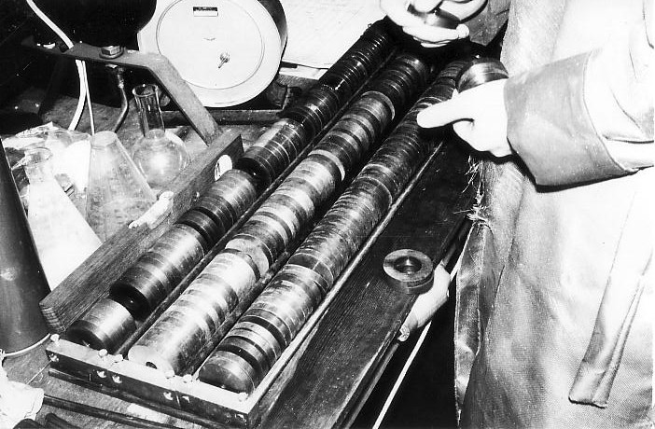
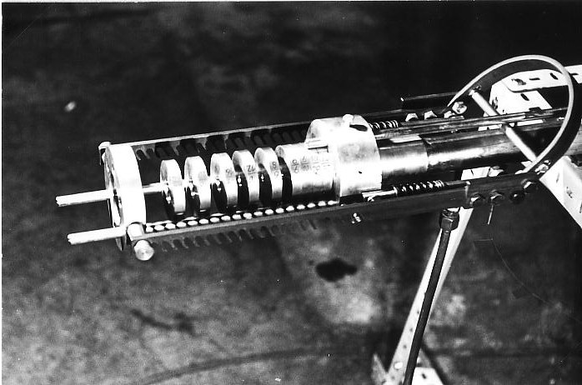
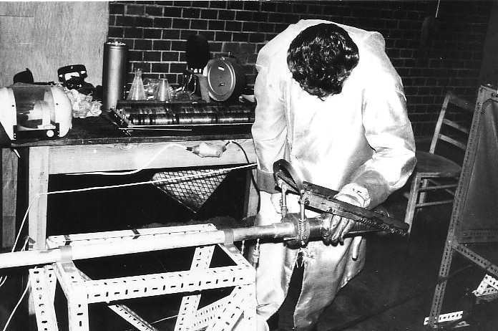
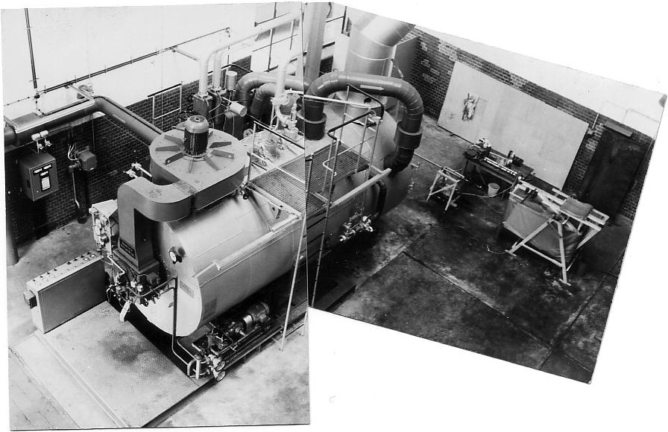
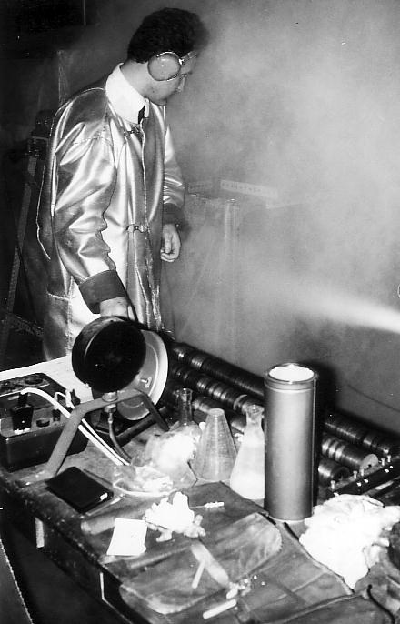
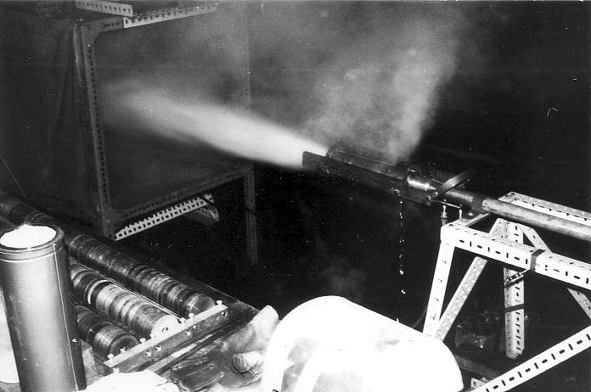
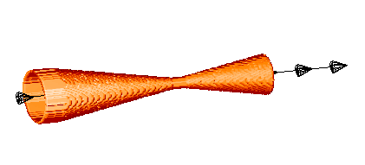
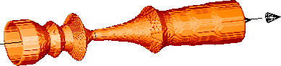
What if … You Had Very Few Trials?
All photos courtesy of Hans-Paul Schwefel.
255 experiments
J. Klockgether and H.-P. Schwefel: Two-phase nozzle and hollow core jet experiments. In Proc. 11th Symp. Engineering Aspects of Magnetohydrodynamcis. Ed. D. Elliott, pp. 141-148. California Institute of Technology, Pasadena, CA, 1970.
32% efficieny improvement!

Slide 131
ES history & parameter control
Two-membered ES: (1+1)
Original multi-membered ES: (µ+1)
Multi-membered ES: (µ+λ), (µ,λ)
Parameter tuning vs. parameter control
Adaptive parameter control
Rechenberg’s 1/5 success rule
Self-adaptation
Mutation Step control

Slide 132
Uncorrelated mutation with one step size
Chromosomes: ⟨ x₁,…,x_{n}, σ ⟩
σ’ = σ • exp(τ • N(0,1))
x’_{i} = x_{i} + σ’ • N(0,1)
Typically the “learning rate” τ ∝ 1/ n^{½}
And we have a boundary rule σ’ < ε₀ ⇒ σ’ = ε₀

Slide 133
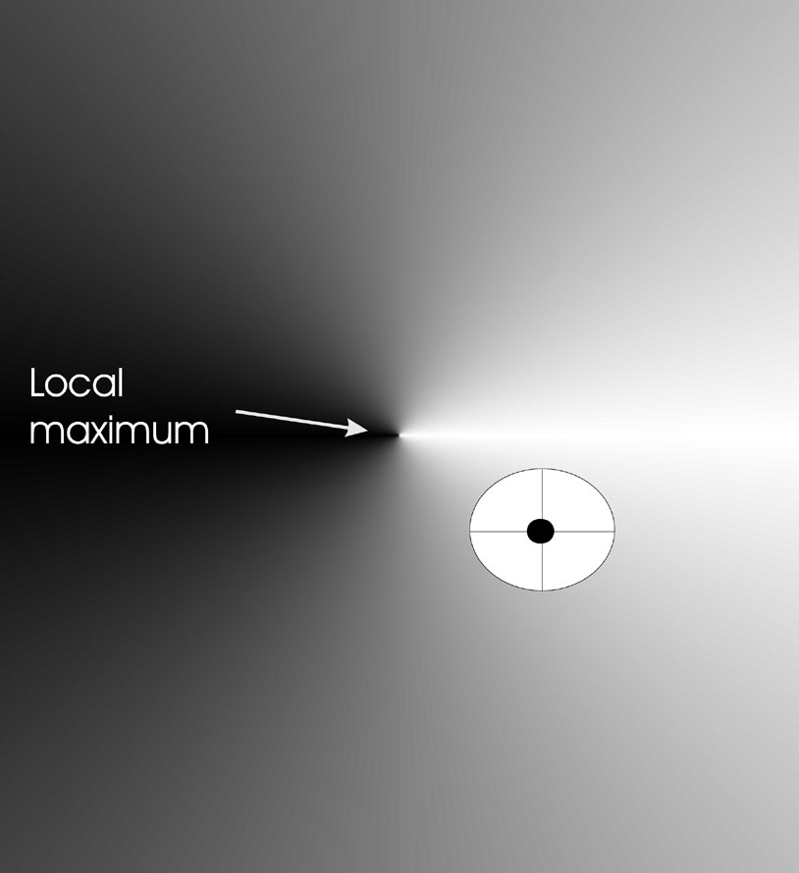
Mutants with equal likelihood
Circle: mutants having same chance to be created

Slide 134
Mutation case 2: Uncorrelated mutation with n σ’s
Chromosomes: ⟨ x₁,…,x_{n}, σ₁,…, σ_{n} ⟩
σ’_{i} = σ_{i} • exp(τ’ • N(0,1) + τ • N_{i} (0,1))
x’_{i} = x_{i} + σ’_{i} • N_{i} (0,1)
Two learning rate parmeters:
τ’ overall learning rate
τ coordinate wise learning rate
τ’ ∝ 1/(2 n)^{½} and τ ∝ 1/(2 n^{½}) ^{½}
τ’ and τ have individual proportionality constants which both have default values of 1
σ_{i}’ < ε₀ ⇒ σ_{i}’ = ε₀

Slide 135
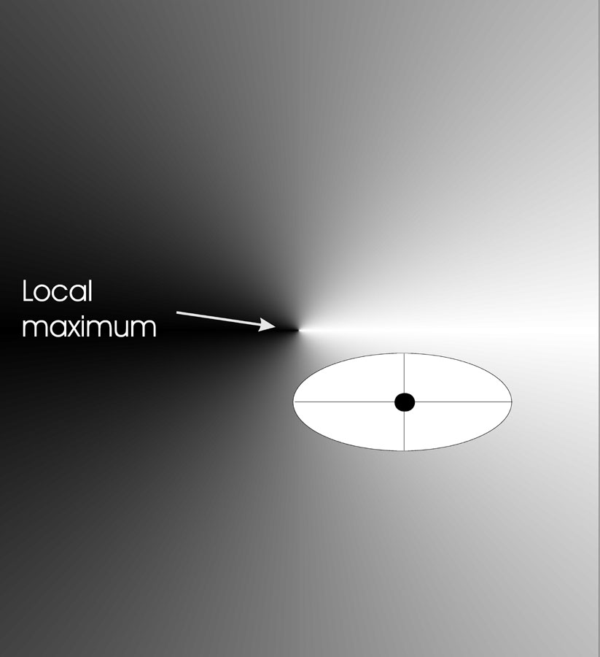
Mutants with equal likelihood
Ellipse: mutants having the same chance to be created

Slide 136
Mutation case 3: Correlated mutations
Chromosomes: ⟨ x₁,…,x_{n}, σ₁,…, σ_{n} ,α₁,…, α_{k} ⟩
where k = n • (n-1)/2
and the covariance matrix C is defined as:
c_{ii} = σ_{i}²
c_{ij} = 0 if i and j are not correlated
c_{ij} = ½ • ( σ_{i}² - σ_{j}² ) • tan(2 α_{ij}) if i and j are correlated
Note the numbering / indices of the α‘s

Slide 137
Correlated mutations cont’d
The mutation mechanism is then:
σ’_{i} = σ_{i} • exp(τ’ • N(0,1) + τ • N_{i} (0,1))
α’_{j} = α_{j} + β • N (0,1)
x ’ = x + N(0,C’)
x stands for the vector ⟨ x₁,…,x_{n} ⟩
C’ is the covariance matrix C after mutation of the α values
τ ∝ 1/(2 n)^{½} and τ ∝ 1/(2 n^{½}) ^{½} and β ≈ 5°
σ_{i}’ < ε₀ ⇒ σ_{i}’ = ε₀ and
| α’_{j} | > π ⇒ α’_{j} = α’_{j} - 2 π sign(α’_{j})

Slide 138
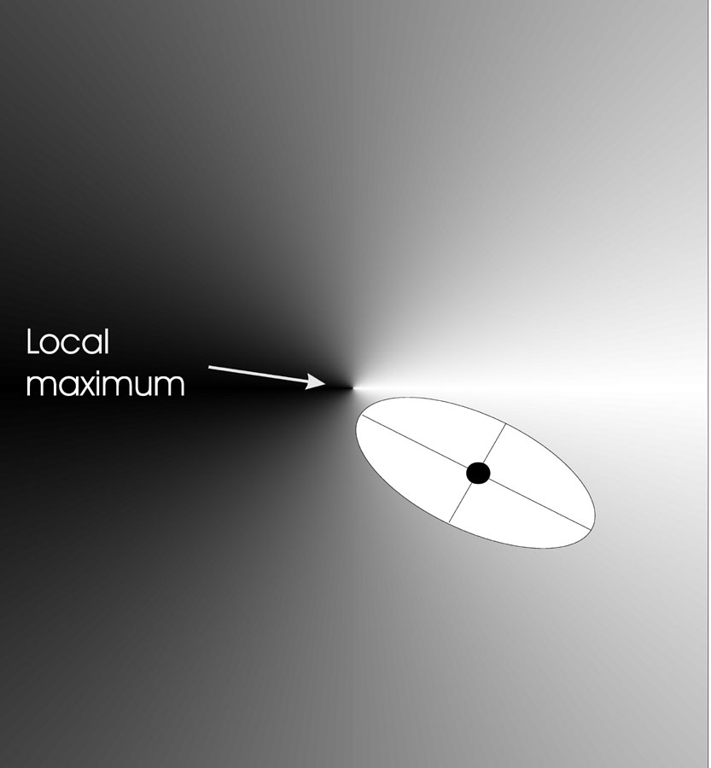
Mutants with equal likelihood
Ellipse: mutants having the same chance to be created

Slide 139
Recombination
Creates one child
Acts per variable / position by either
Averaging parental values, or
Selecting one of the parental values
From two or more parents by either:
Using two selected parents to make a child
Selecting two parents for each position anew

Slide 140
Names of recombinations
 | Two fixed parents | Two parents selected for each i
z_{i} = (x_{i} + y_{i})/2 | Local intermediary | Global intermediary
z_{i} is x_{i} or y_{i} chosen randomly | Local discrete | Global discrete

Slide 141
Multimodal Problems
Multimodal def.: multiple local optima and at least one local optimum is not globally optimal
Adaptive landscapes & neighborhoods
Basins of attraction & Niches
Motivation for identifying a diverse set of high quality solutions:
Allow for human judgment
Sharp peak niches may be overfitted

Slide 142
Restricted Mating
Panmictic vs. restricted mating
Finite pop size + panmictic mating -> genetic drift
Local Adaptation (environmental niche)
Punctuated Equilibria
Evolutionary Stasis
Demes
Speciation (end result of increasingly specialized adaptation to particular environmental niches)

Slide 143
EA spaces
Biology | EA
Geographical | Algorithmic
Genotype | Representation
Phenotype | Solution

Slide 144
Implicit diverse solution identification (1)
Multiple runs of standard EA
Non-uniform basins of attraction problematic
Island Model (coarse-grain parallel)
Punctuated Equilibria
Epoch, migration
Communication characteristics
Initialization: number of islands and respective population sizes

Slide 145
Implicit diverse solution identification (2)
Diffusion Model EAs
Single Population, Single Species
Overlapping demes distributed within Algorithmic Space (e.g., grid)
Equivalent to cellular automata
Automatic Speciation
Genotype/phenotype mating restrictions

Slide 146
Explicit 1: Fitness Sharing
Restricts the number of individuals within a given niche by “sharing” their fitness, so as to allocate individuals to niches in proportion to the niche fitness
need to set the size of the niche σ_{share} in either genotype or phenotype space
run EA as normal but after each gen set

Slide 147
Explicit 2: Crowding
Attempts to distribute individuals evenly amongst niches
relies on the assumption that offspring will tend to be close to parents
uses a distance metric in ph/g enotype space
randomly shuffle and pair parents, produce 2 offspring
2 parent/offspring tournaments - pair so that d(p1,o1)+d(p2,o2) < d(p1,02) + d(p2,o1)

Slide 148
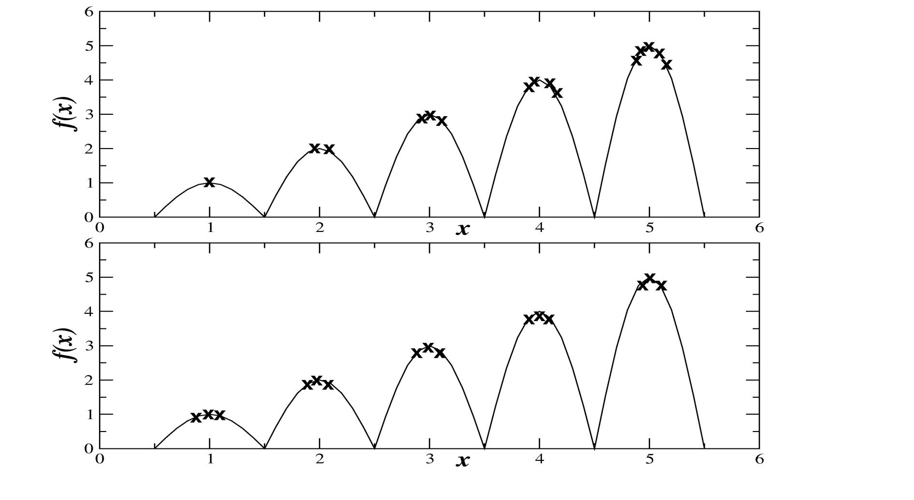
Fitness Sharing vs. Crowding

Slide 149
Game-Theoretic Problems
Adversarial search: multi-agent problem with conflicting utility functions
Ultimatum Game
Select two subjects, A and B
Subject A gets 10 units of currency
A has to make an offer (ultimatum) to B, anywhere from 0 to 10 of his units
B has the option to accept or reject (no negotiation)
If B accepts, A keeps the remaining units and B the offered units; otherwise they both loose all units

Slide 150
Real-World Game-Theoretic Problems
Real-world examples:
economic & military strategy
arms control
cyber security
bargaining
Common problem: real-world games are typically incomputable

Slide 151
Armsraces
Military armsraces
Prisoner’s Dilemma
Biological armsraces

Slide 152
Approximating incomputable games
Consider the space of each user’s actions
Perform local search in these spaces
Solution quality in one space is dependent on the search in the other spaces
The simultaneous search of co-dependent spaces is naturally modeled as an armsrace

Slide 153
Evolutionary armsraces
Iterated evolutionary armsraces
Biological armsraces revisited
Iterated armsrace optimization is doomed!

Slide 154
Coevolutionary Algorithm (CoEA)
A special type of EAs where the fitness of an individual is dependent on other individuals. (i.e., individuals are explicitely part of the environment)
Single species vs. multiple species
Cooperative vs. competitive coevolution

Slide 155
CoEA difficulties (1)
Disengagement
Occurs when one population evolves so much faster than the other that all individuals of the other are utterly defeated, making it impossible to differentiate between better and worse individuals without which there can be no evolution

Slide 156
CoEA difficulties (2)
Cycling
Occurs when populations have lost the genetic knowledge of how to defeat an earlier generation adversary and that adversary re-evolves
Potentially this can cause an infinite loop in which the populations continue to evolve but do not improve

Slide 157
CoEA difficulties (3)
Suboptimal Equilibrium
(aka Mediocre Stability)
Occurs when the system stabilizes in a suboptimal equilibrium

Slide 158
Case Study from Critical Infrastructure Protection
Infrastructure Hardening
Hardenings (defenders) versus contingencies (attackers)
Hardenings need to balance spare flow capacity with flow control

Slide 159
Case Study from Automated Software Engineering
Automated Software Correction
Programs (defenders) versus test cases (attackers)
Programs encoded with Genetic Programming
Program specification encoded in fitness function (correctness critical!)

Slide 160
Memetic Algorithms
Dawkins’ Meme – unit of cultural transmission
Addition of developmental phase (meme-gene interaction)
Baldwin Effect
Baldwinian EAs vs. Lamarckian EAs
Probabilistic hybrid

Slide 161
Structure of a Memetic Algorithm
Heuristic Initialization
Seeding
Selective Initialization
Locally optimized random initialization
Mass Mutation
Heuristic Variation
Variation operators employ problem specific knowledge
Heuristic Decoder
Local Search

Slide 162
Memetic Algorithm Design Issues
Exacerbation of premature convergence
Limited seeding
Diversity preserving recombination operators
Non-duplicating selection operators
Boltzmann selection for preserving diversity (Metropolis criterion – page 142 in textbook)
Local Search neighborhood structure vs. variation operators
Multiple local search algorithms (coevolving)

Slide 163
Black-Box Search Algorithms
Many complex real-world problems can be formulated as generate-and-test problems
Black-Box Search Algorithms (BBSAs) iteratively generate trial solutions employing solely the information gained from previous trial solutions, but no explicit problem knowledge
Notes:
Performance is measured in terms of the quality of the individuals discovered by the search heuristic. Formally, a performance metric maps sequences of objective values to a real number indicating how well a heuristic which observed that sequence performed. Examples of performance metrics include the last objective value discovered by the algorithm or the greatest objective value discovered so far.

Slide 164
Practitioner’s Dilemma
How to decide for given real-world problem whether beneficial to formulate as black-box search problem?
How to formulate real-world problem as black-box search problem?
How to select/create BBSA?
How to configure BBSA?
How to interpret result?
All of the above are interdependent!
Notes:
Performance is measured in terms of the quality of the individuals discovered by the search heuristic. Formally, a performance metric maps sequences of objective values to a real number indicating how well a heuristic which observed that sequence performed. Examples of performance metrics include the last objective value discovered by the algorithm or the greatest objective value discovered so far.

Slide 165
Theory-Practice Gap
While BBSAs, including EAs, steadily are improving in scope and performance, their impact on routine real-world problem solving remains underwhelming
A scalable solution enabling domain-expert practitioners to routinely solve real-world problems with BBSAs is needed

Slide 166
Two typical real-world problem categories
Solving a single-instance problem:
automated BBSA selection
Repeatedly solving instances of a problem class:
evolve custom BBSA

Slide 167
Part I: Solving Single-Instance Problems Employing Automated BBSA Selection

Slide 168
Requirements
Need diverse set of high-performance BBSAs
Need automated approach to select most appropriate BBSA from set for a given problem
Need automated approach to configure selected BBSA

Slide 169
Automated BBSA Selection
Given a set of BBSAs, a priori evolve a set of benchmark functions which cluster the BBSAs by performance
Given a real-world problem, create a surrogate fitness function
Find the benchmark function most similar to the surrogate
Execute the corresponding BBSA on the real-world problem

Slide 170
A Priori, Once Per BBSA Set
BBSA₁
BBSA₂
…
BBSA_{n}
Benchmark Generator
BBSA₁
BP₁
BBSA₂
BP₂
…
BBSA_{n}
BP_{n}
Notes:
A priori, for each BBSA in a set of BBSAs, generate a benchmark problem where that BBSA consistently produces a better result than any other BBSA in the set and also generate a heuristic to classify the benchmark problems.
Given a real-world problem, sample its objective function space to create a surrogate objective function. Employ the aforementioned heuristic to classify the real-world problem based on its surrogate objective function and select the corresponding most appropriate BBSA.

Slide 171
Per Problem Instance
Real-World Problem
Sampling Mechanism
Surrogate Objective Function
Match with most “similar” BP_{k}
Apply appropriate BBSA_{k}
Notes:
A priori, for each BBSA in a set of BBSAs, generate a benchmark problem where that BBSA consistently produces a better result than any other BBSA in the set and also generate a heuristic to classify the benchmark problems.
Given a real-world problem, sample its objective function space to create a surrogate objective function. Employ the aforementioned heuristic to classify the real-world problem based on its surrogate objective function and select the corresponding most appropriate BBSA.

Slide 172
Requirements
Need diverse set of high-performance BBSAs
Need automated approach to select most appropriate BBSA from set for a given problem
Need automated approach to configure selected BBSA

Slide 173
AI/CI courses at S&T
CS5400 Introduction to Artificial Intelligence (FS2016, SP2017)
CS5401 Evolutionary Computing (FS2016, FS2017)
CS5402 Data Mining & Machine Learning (SS2016,FS2016,SS2017)
CS5403 Intro to Robotics (FS2015)
CS5404 Intro to Computer Vision (FS2016)

Slide 174
AI/CI courses at S&T
CS6001 Machine Learning in Computer Vision (SP2016, SP2017)
CS6400 Advanced Topics in AI (SP2013)
CS6401 Advanced Evolutionary Computing (SP2016)
CS6402 Advanced Topics in Data Mining (SP2017)

Slide 175
AI/CI courses at S&T
CS6403 Advanced Topics in Robotics
CS6405 Clustering Algorithms
CpE 5310 Computational Intelligence
CpE 5460 Machine Vision
EngMgt 5413 Introduction to Intelligent Systems
SysEng 5212 Introduction to Neural Networks and Applications
SysEng 6213 Advanced Neural Networks

